Slide 1
Hiring Process Analytics
Project Done By: Sayan Kashyap

Slide 2
Project Description
As a data analyst at a multinational company like Google, my role is to analyze the company's hiring process data to draw meaningful insights. By working with a dataset containing records of previous hires, we will handle missing data from the given dataset.
Through statistical measures and visualizations, we will summarize our findings, including the gender distribution of hires, the average salary, salary distribution, departmental analysis, etc. Our insights will contribute to improving the hiring process and making better decisions in the future.

Slide 3
Approach
First of all we collect the dataset and analyze in Microsoft Excel then we clean the data to remove any duplicate entries and make sure that the data is properly formatted, then we check and identify the outliers and remove any outliers that may have significant impact on the analysis.
We will perform relevant descriptive statistic calculations to gain a general understanding of dataset then we extract the useful insights using statistical analysis and visualize the insights using data visualization methods.

Slide 4


Tech-Stack Used
Microsoft Excel 2010
Microsoft PowerPoint 2010

Slide 5
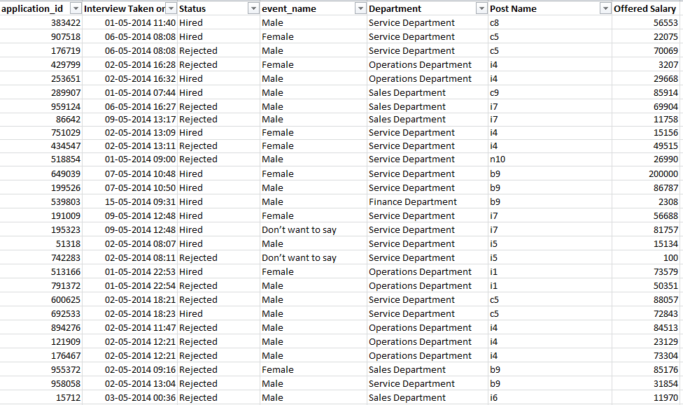
Insights: Data Analytics Tasks

Slide 6
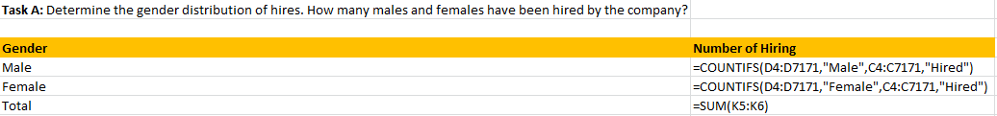
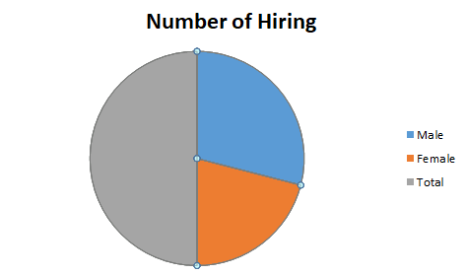

A. Hiring Analysis:
Formula:
Result:

Slide 7
B. Salary Analysis:
Formula :
Result:

Slide 8
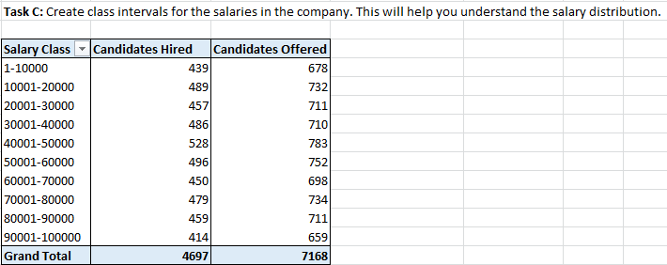
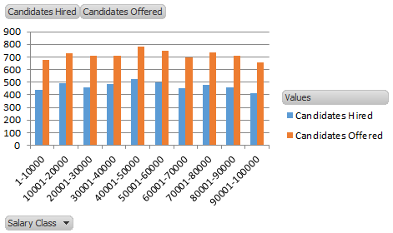
C. Salary Distribution:
Class Interval:

Slide 9
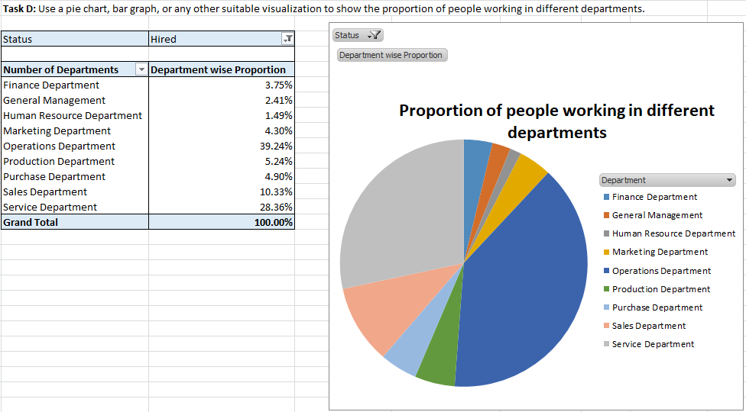
D. Departmental Analysis:

Slide 10
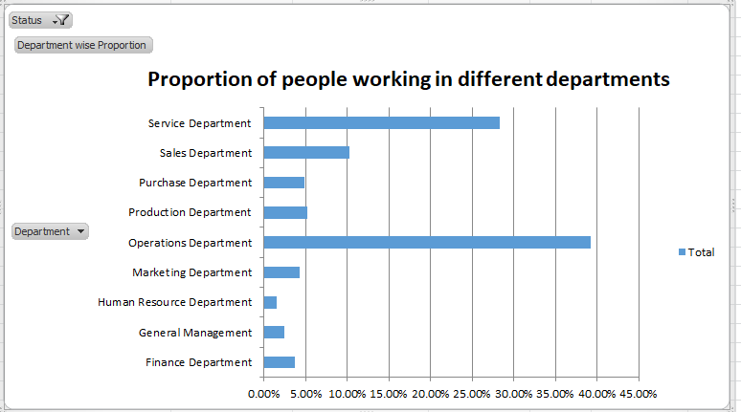

Slide 11
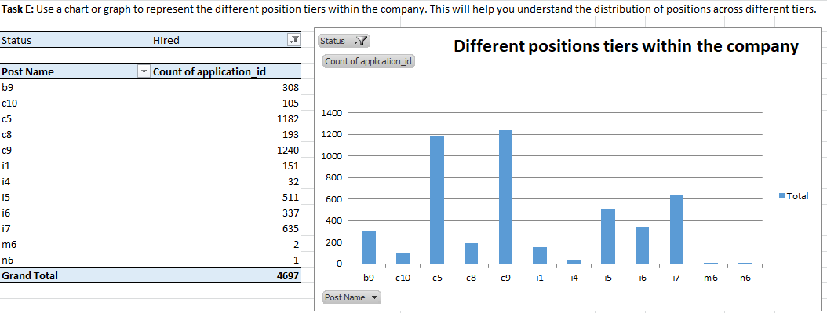
E. Position Tier Analysis:

Slide 12
Result
This project has helped in getting a hands on experience in real life data set and how we clean, manipulate, visualize and draw insights from the data.
We have done the analysis on the provided dataset as per the questions asked and provided the necessary insights as well as we tried to plot the necessary charts and graphs as per requirement.

Slide 13
Conclusion
This project helped me in understanding how important Data Analytics is for Hiring Process of an organization as it provides valuable insights such as number of rejections, reason for rejections, profile of applicants, vacancies etc. which helps the hiring department to take data driven decisions.

Slide 14
Thank you
Excel Sheet File Source

